Slide 1

Throwing and catching exceptions

Slide 2
Outline
In this lesson, we will:
  Review assertions
  Be introduced to exception classes
  See that exceptions can be thrown,
  and may terminate the execution of the program
  Learn how to catch exceptions and deal with them

Slide 3
Assertions
To this point, we have discussed assertions
  Assertions are powerful and useful because:
    They terminate the program immediately indicating the problem
    They can all be turned off,
    meaning you can turn all assertions on during code development,
    but turn them off when you build your releases
  Turning assertions off is as simple as including:
  #define NDEBUG
    Not even the condition is performed,
    turning off assertions,
    it is equivalent to erasing all assertions before compilation

Slide 4
Assertions
The issue with assertions, however, is in released code,
they would automatically terminate the user’s program
  This does not make for happy clients or users…
“Nurse, turn on the artificial lung.”
“Yes, doctor.”
“Nurse, turn the artificial lung back on!”
“Doctor, it says something about “disk full”.”
assertion "disk_full == false" failed: file "record_data.cpp", line 666, fuction: int write_data()
Aborted (core dumped)

Slide 5
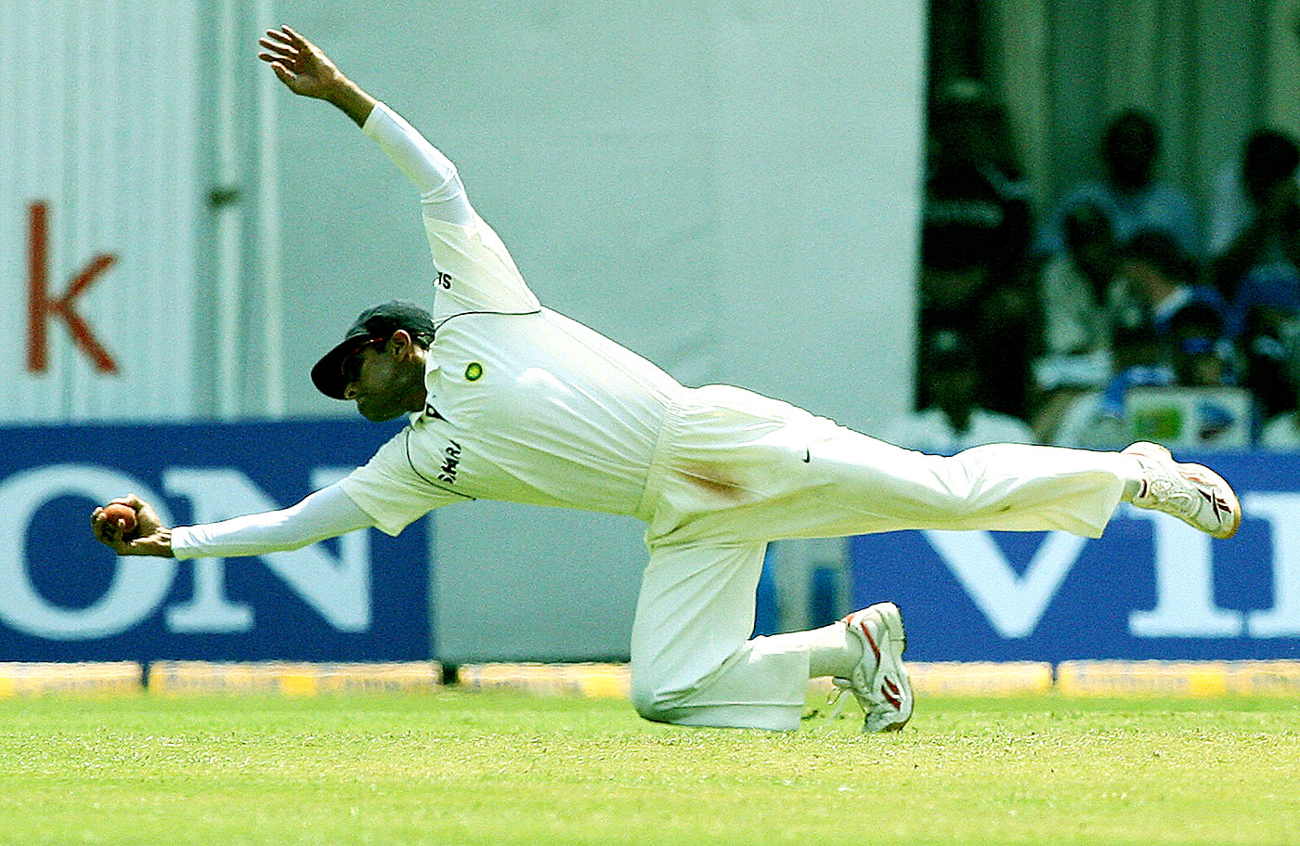

Assertions
We need an approach to assertions that can more safely be used
in deployed code
  First, we will present how we can signal that there is a problem
    We will throw an exception
  Next, we will see how we can correctly deal with problems
    We will also catch exceptions
The New Indian Express
The Cricket Monthly

Slide 6
Calling member functions
When something unexpected happens, you can throw an exception
  There are numerous classes that are exceptions all defined in the stdexcept library:
    Logical errors Run-time errors
    std::logic_error std::runtime_error
    std::domain_error std::range_error
    std::invalid_argument std::overflow_error
    std::length_error std::underflow_error
    std::out_of_range

Slide 7
Throwing exceptions
Just like we return a value,
we can throw an instance of one of these classes:
    int isqrt( int n ) {
    if ( n < 0 ) {
    throw std::domain_error{
    "Cannot compute the square root of "
    + std::to_string( n )
    };
    } else {
    // Calculate the integer square root of 'n'
    // ...
    }
    }

Slide 8
Throwing exceptions
    int isqrt( int n ) {
    if ( n < 0 ) {
    throw std::domain_error{
    "Cannot compute the square root of " + std::to_string( n )
    };
    } else {
    int result{0};
    int rem{0};
    for ( int k{15}; k >= 0; --k ) {
    rem <<= 2;
    rem += ( n >> (k << 1) ) & 3;
    result <<= 1;
    int sub{ (result << 1) | 1 };
    if ( sub <= rem ) {
    result |= 1;
    rem -= sub;
    }
    }
    return result;
    }
    }

Slide 9
Throwing exceptions
If you call this function with an invalid argument,
like an assertion, the program terminates:
    #include <iostream>
    // Function declarations
    int main();
    int isqrt( int n );
    int main() {
    std::cout << isqrt( -10 ) << std::endl;
    return 0;
    }
Output:
terminate called after throwing an instance of 'std::domain_error'
what(): Cannot compute the square root of -10
Aborted (core dumped)

Slide 10
Catching exceptions
If all you do is throw exceptions,
exceptions are no different than assertions that fail
  The difference, however, is that we can catch exceptions
    If an exception is caught, the program continues executing

Slide 11
Catching exceptions
    int main() {
    try {
    std::cout << isqrt( 53209825 ) << std::endl;
    std::cout << isqrt( 95810392 ) << std::endl;
    std::cout << isqrt( 139502589 ) << std::endl;
    } catch ( std::domain_error &e ) {
    std::cout << "An exception was caught" << std::endl;
    std::cout << " – the error string was \"" << e.what()
    << "\"" << std::endl;
    }
    std::cout << "Please try again..." << std::endl;
    return 0;
    }
Output:
7294
9788
11811
Please try again...

Slide 12
Catching exceptions
    int main() {
    try {
    std::cout << isqrt( 53209825 ) << std::endl;
    std::cout << isqrt( -95810392 ) << std::endl;
    std::cout << isqrt( 139502589 ) << std::endl;
    } catch ( std::domain_error &e ) {
    std::cout << "An exception was caught" << std::endl;
    std::cout << " – the error string was \"" << e.what()
    << "\"" << std::endl;
    }
    std::cout << "Please try again..." << std::endl;
    return 0;
    }
Output:
7294
An exception was caught
– the error string was "Cannot compute the square root of -95810392"
Please try again...

Slide 13
Catching exceptions
If you don’t know what you’re catching, you can still do that:
    int main() {
    try {
    std::cout << isqrt( 53209825 ) << std::endl;
    std::cout << isqrt( 95810392 ) << std::endl;
    std::cout << isqrt( -139502589 ) << std::endl;
    } catch ( ... ) {
    std::cout << "An exception occurred..." << std::endl;
    }
    std::cout << "Please try again..." << std::endl;
    return 0;
    }
Output:
7294
9788
An exception occurred...
Please try again...

Slide 14
Catching exceptions
If the exception classes don’t match,
the exception continues to be thrown:
    int main() {
    try {
    std::cout << isqrt( 53209825 ) << std::endl;
    std::cout << isqrt( 95810392 ) << std::endl;
    std::cout << isqrt( -139502589 ) << std::endl;
    } catch ( std::range_error &e ) {
    std::cout << "A range error was caught..." << std::endl;
    }
    std::cout << "Please try again..." << std::endl;
    return 0;
    }
Output:
7294
9788
terminate called after throwing an instance of 'std::domain_error'
what(): Cannot compute the square root of -139502589
Aborted (core dumped)

Slide 15
Cascading catch blocks
A try-catch statement can have cascading catch blocks
  The first catch block that is matched is the one executed
    int main() {
    try {
    std::cout << isqrt( 53209825 ) << std::endl;
    std::cout << isqrt( 95810392 ) << std::endl;
    std::cout << isqrt( -139502589 ) << std::endl;
    } catch ( std::range_error &e ) {
    std::cout << "A range error was caught..." << std::endl;
    } catch ( std::domain_error &e ) {
    std::cout << "A domain error was caught..." << std::endl;
    } catch ( ... ) {
    std::cout << "A different error was caught..." << std::endl;
    }
    std::cout << "Please try again..." << std::endl;
    return 0;
    }
Output:
7294
9788
A domain error was caught...
Please try again...

Slide 16
Cascading catch blocks
A try-catch statement can have cascading catch blocks
  The first catch block that is matched is the one executed
    int main() {
    try {
    std::cout << isqrt( 53209825 ) << std::endl;
    std::cout << isqrt( 95810392 ) << std::endl;
    std::cout << isqrt( -139502589 ) << std::endl;
    } catch ( ... ) {
    std::cout << "An error was caught..." << std::endl;
    } catch ( std::range_error &e ) {
    std::cout << "A range error was caught..." << std::endl;
    } catch ( std::domain_error &e ) {
    std::cout << "A domain error was caught..." << std::endl;
    }
    std::cout << "Please try again..." << std::endl;
    return 0;
    }
Output:
7294
9788
An error was caught...
Please try again...

Slide 17
Assertions or throwing exceptions?
In this course, we will continue to use both assertions and throws
  Assertions will be used to check that the code is correct:
    For example, the conditions we expect to be true are actually true
  Exceptions will be thrown if there are potential errors during the execution of the code that must be dealt with
    For example, invalid arguments, or a result that is invalid
Failure to deal with exceptions have led to numerous problems
  The first Arian 5 rocket launch resulted in the destruction of the rocket a minute after launch due to an uncaught exception
  The Clementine satellite simply allowed division-by-zero errors to cause the system to reboot

Slide 18
Why not use exceptions everywhere?
Why not use exceptions everywhere?
  Exceptions are expensive and require significant infrastructure
  Suppose you have a try-catch statement:
    You call a function in the try block
    That function calls another function
    That function calls another function, which calls another,
    which calls another,
      Which finally throws an exception you are catching
    Each called function has parameters and local variables
    on the call stack, and all this must be undone without
    executing any more statements in those functions
      We must jump all the way back to the appropriate catch block…
That is a lot of overhead…
  Fine for programs running on general purpose desktop, laptop, etc.
  Not so great for embedded or real-time systems

Slide 19
An application of a try-catch statement
An example of using try-catch statement:
  You set up a network connection
  You then execute code that expects that network connection to be up
    There may be a significant amount of code that is being executed
  You don’t want every single function called to deal with network failures…
  Instead, if ever the network connection fails,
  the first function to detect this failure can throw an appropriate exception back to the top level where the corresponding catch block can either:
    Try to re-establish the network connection, or
    Signal that the network connection failed
  If the network connection fails to be re-established,
  a user may be prompted what to do next, or
  the failure may simply be entered into an error log

Slide 20
Summary
Following this lesson, you now
  Have been exposed to the various exception classes
    If an exception is thrown and not caught,
    the program terminates
  Know that each exception class has a what() member function
  Know that thrown exceptions inside try blocks can be caught with corresponding catch blocks
    Like cascading conditionals, you can have cascading catch blocks
    The catch( ... ) is similar to an if ( true ) condition
  Know that once the first matching catch block is finished executing,
  the program keeps on executing as per normal
    No evidence remains that something has occurred

Slide 21
References
[1] https://en.wikipedia.org/wiki/C++_classes
[2] https://en.wikipedia.org/wiki/Exception_handling
[3] https://www.cplusplus.com/reference/stdexcept/

Slide 22



Colophon
These slides were prepared using the Georgia typeface. Mathematical equations use Times New Roman, and source code is presented using Consolas.
The photographs of lilacs in bloom appearing on the title slide and accenting the top of each other slide were taken at the Royal Botanical Gardens on May 27, 2018 by Douglas Wilhelm Harder. Please see
https://www.rbg.ca/
for more information.

Slide 23
Disclaimer
These slides are provided for the ece 150 Fundamentals of Programming course taught at the University of Waterloo. The material in it reflects the authors’ best judgment in light of the information available to them at the time of preparation. Any reliance on these course slides by any party for any other purpose are the responsibility of such parties. The authors accept no responsibility for damages, if any, suffered by any party as a result of decisions made or actions based on these course slides for any other purpose than that for which it was intended.

